Slide 1
Creating Meaningful Career Pathway Engagement During a Campus Visit
Cassie Blickem, Director Valley Education for Employment System (VALEES) EFE #130 | Linda O’Connell-Knuth, Assistant Professor Early Childhood Education Waubonsee Community College

Slide 2
Valley Education for Employment System
Legislatively mandated intermediary agency between the Illinois State Board of Education and member districts to support Career and Technical Education.

Slide 3
Waubonsee Community College:
District: #516
Campuses: 4 campuses (Downtown Aurora, Fox Valley, Plano, & Sugar Grove)
Area Served: 624-square-mile district serving 5 counties: Kane County & portions of Kendall, DeKalb, LaSalle and Will counties.
Students: 14,375 credit students & 2,413 non-credit
One of the Area’s Largest Employers: 1,103 Employees (Faculty, Administrators, Support Staff)

Slide 4
Program Committees: The Heart of VALEES
Secondary and post-secondary (community college) faculty who meet 3-4 times per year in CTE program areas.
Half day to full day meetings
One meeting per year that includes business advisory input
Agenda driven by committee member input and developed by VALEES

Slide 5
Early Childhood Education Visit Day
Early Childhood Education Visit Day
160 students in secondary early childhood program (2015, 2016)
Faculty programmed as result of program committee relationship
Student panel with professional development workshops

Slide 6
Welcome to our participating schools:
AGENDA
9:00-9:20 – Welcome from the Waubonsee Community College faculty
9:20-9:50 – Current student panel and questions
9:50-10:10 – Break (Grab a snack and network)
10:10-10:25 – Admission advisor and counselor
10:25-10:35 – VALEES: Applying for Articulated Credit
10:40-11:40 – Workshop 1
11:45-12:25 – Lunch
12:30-1:30 – Workshop 2
Fox Valley Career Center
Geneva High School
Indian Valley Vocational Center
West Aurora High School

Slide 8
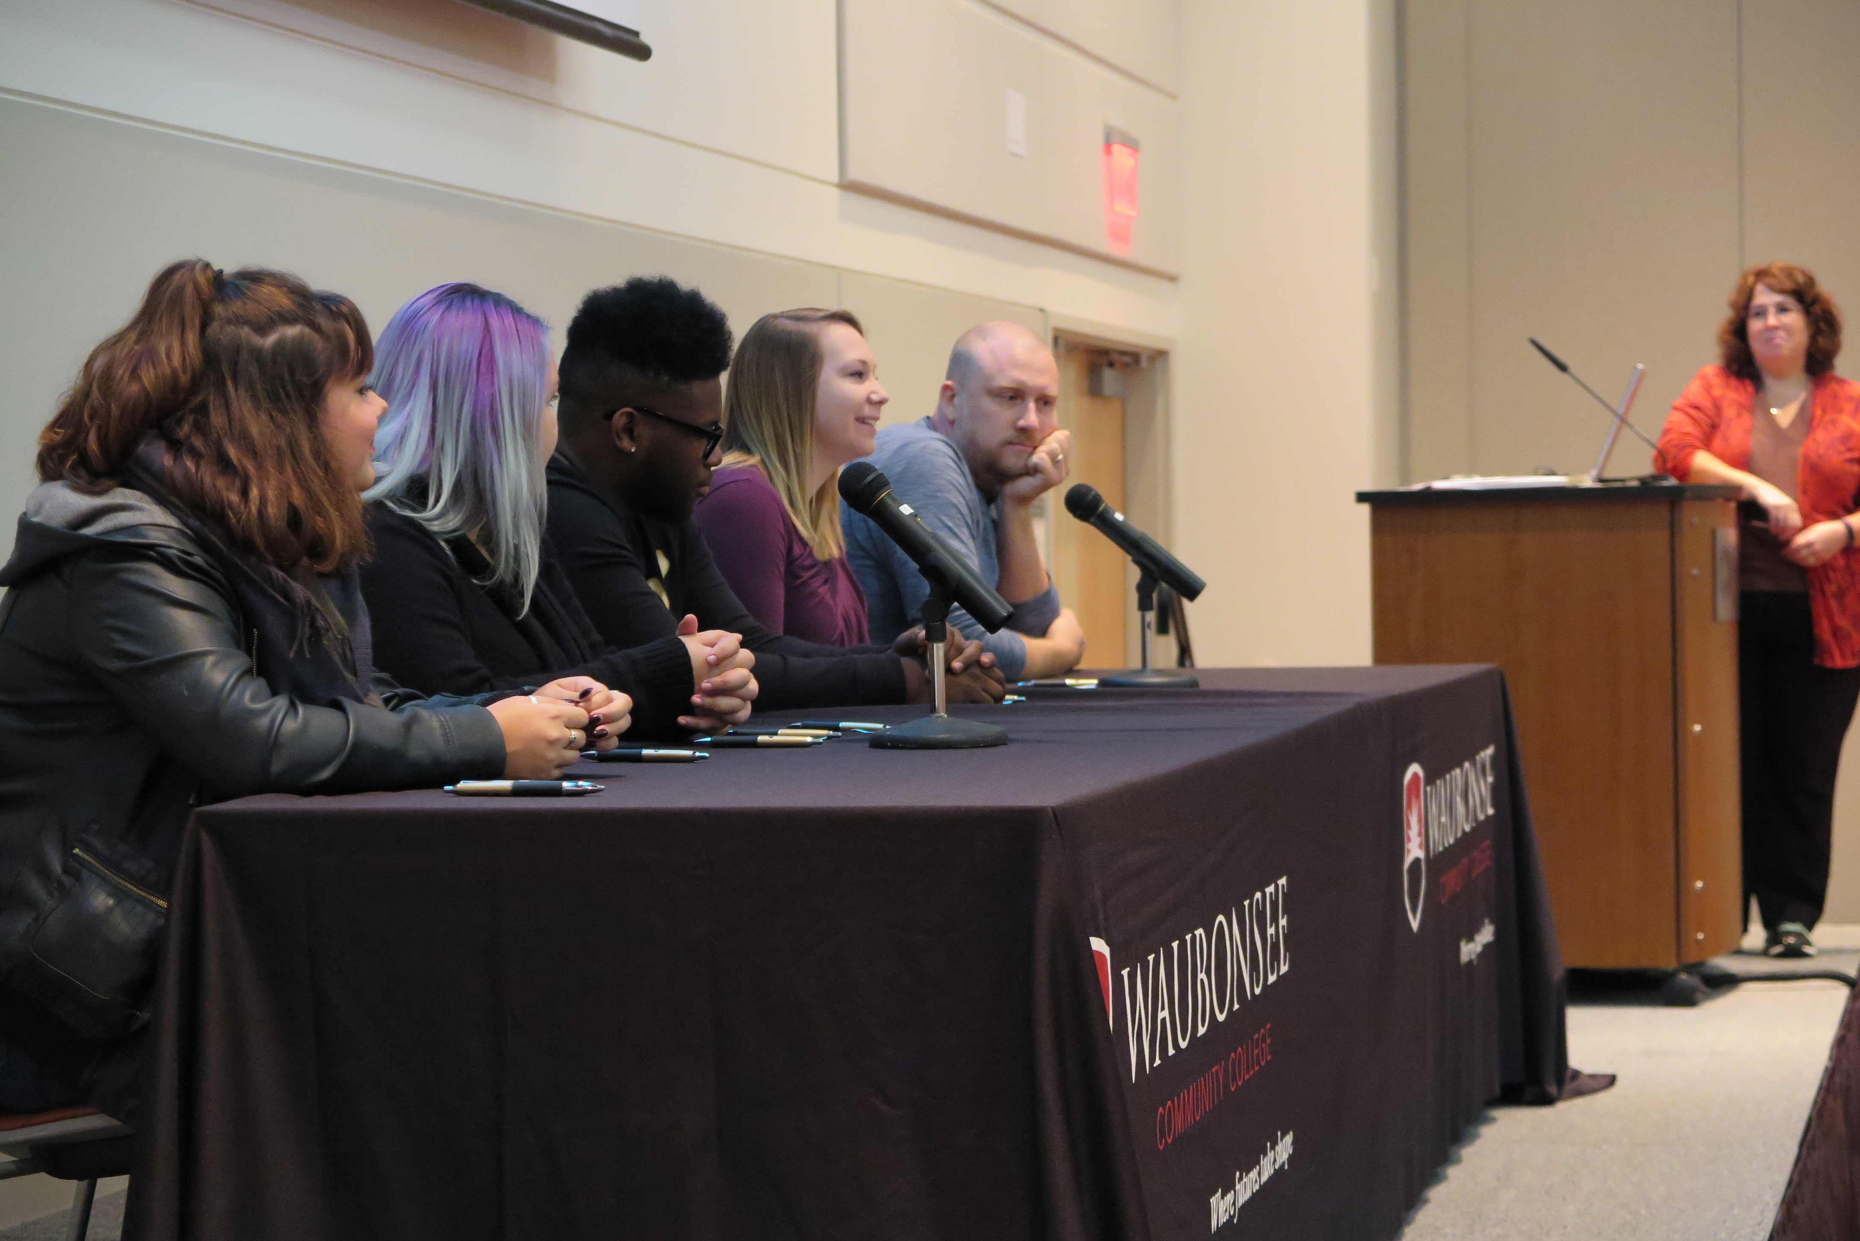

Slide 9
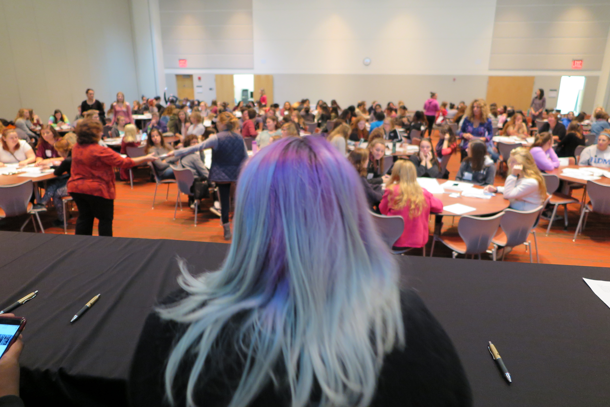

Slide 10
Welcome to our participating schools:
AGENDA
9:00-9:20 – Welcome from the Waubonsee Community College faculty
9:20-9:50 – Current student panel and questions
9:50-10:10 – Break (Grab a snack and network)
10:10-10:25 – Admission advisor and counselor
10:25-10:35 – VALEES: Applying for Articulated Credit
10:40-11:40 – Workshop 1
11:45-12:25 – Lunch
12:30-1:30 – Workshop 2
Fox Valley Career Center
Geneva High School
Indian Valley Vocational Center
West Aurora High School

Slide 12
Welcome to our participating schools:
AGENDA
9:00-9:20 – Welcome from the Waubonsee Community College faculty
9:20-9:50 – Current student panel and questions
9:50-10:10 – Break (Grab a snack and network)
10:10-10:25 – Admission advisor and counselor
10:25-10:35 – VALEES: Applying for Articulated Credit
10:40-11:40 – Workshop 1
11:45-12:25 – Lunch
12:30-1:30 – Workshop 2
Fox Valley Career Center
Geneva High School
Indian Valley Vocational Center
West Aurora High School

Slide 13
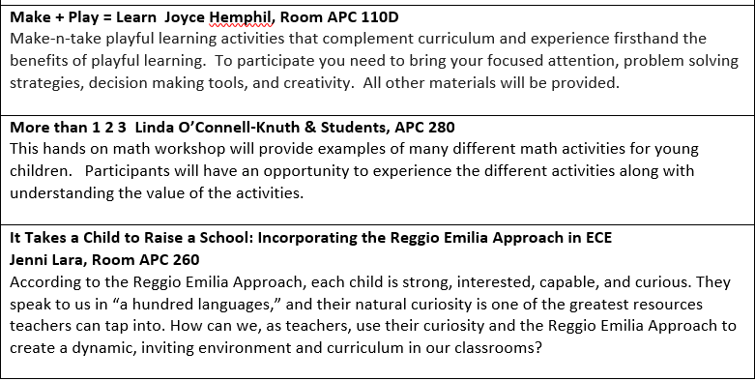

Slide 14
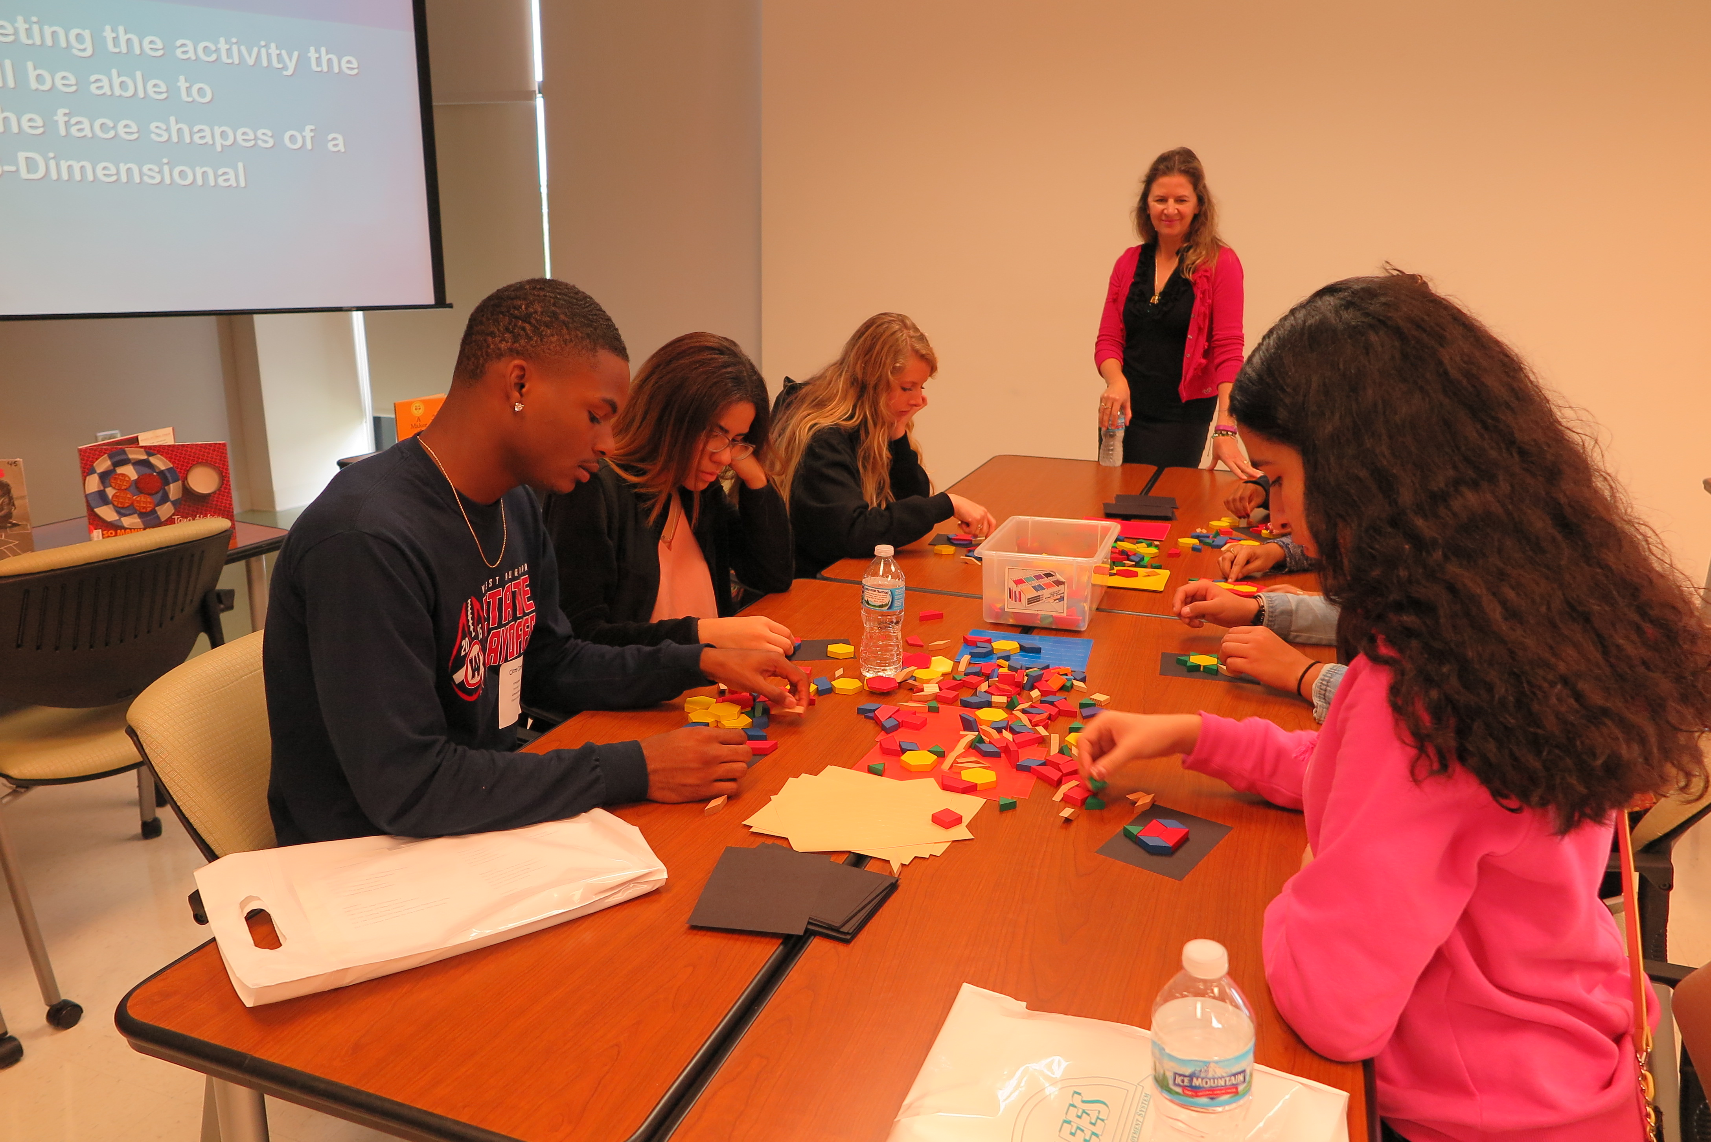

Slide 15
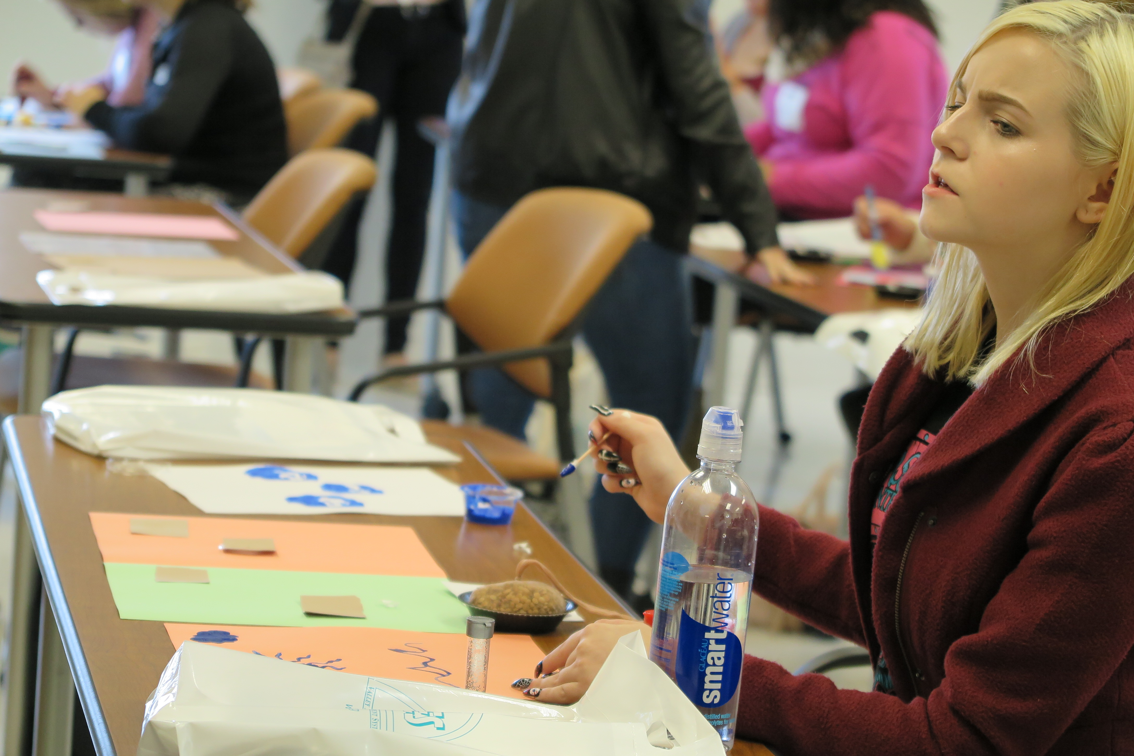

Slide 16
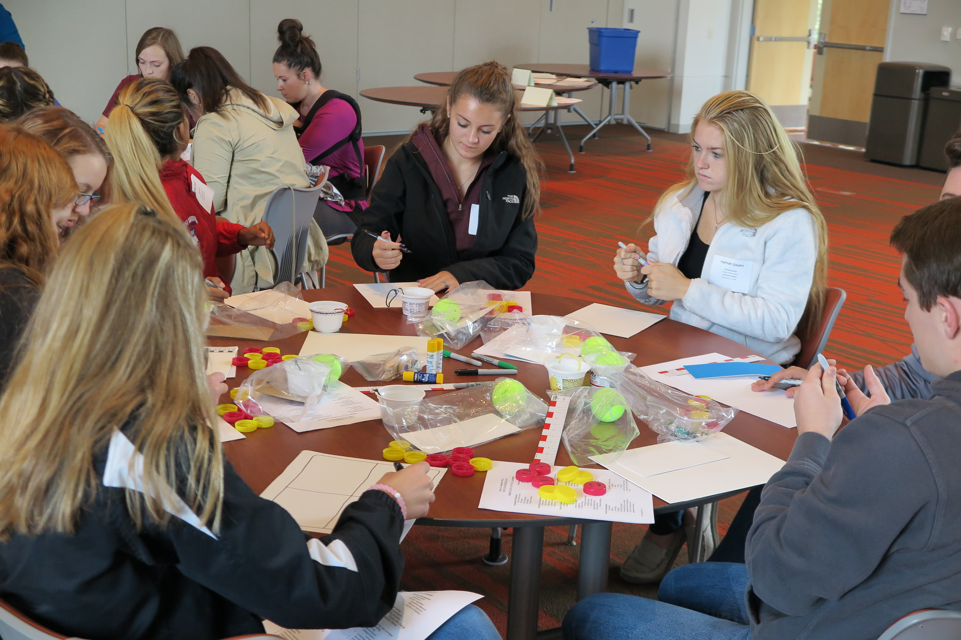

Slide 17
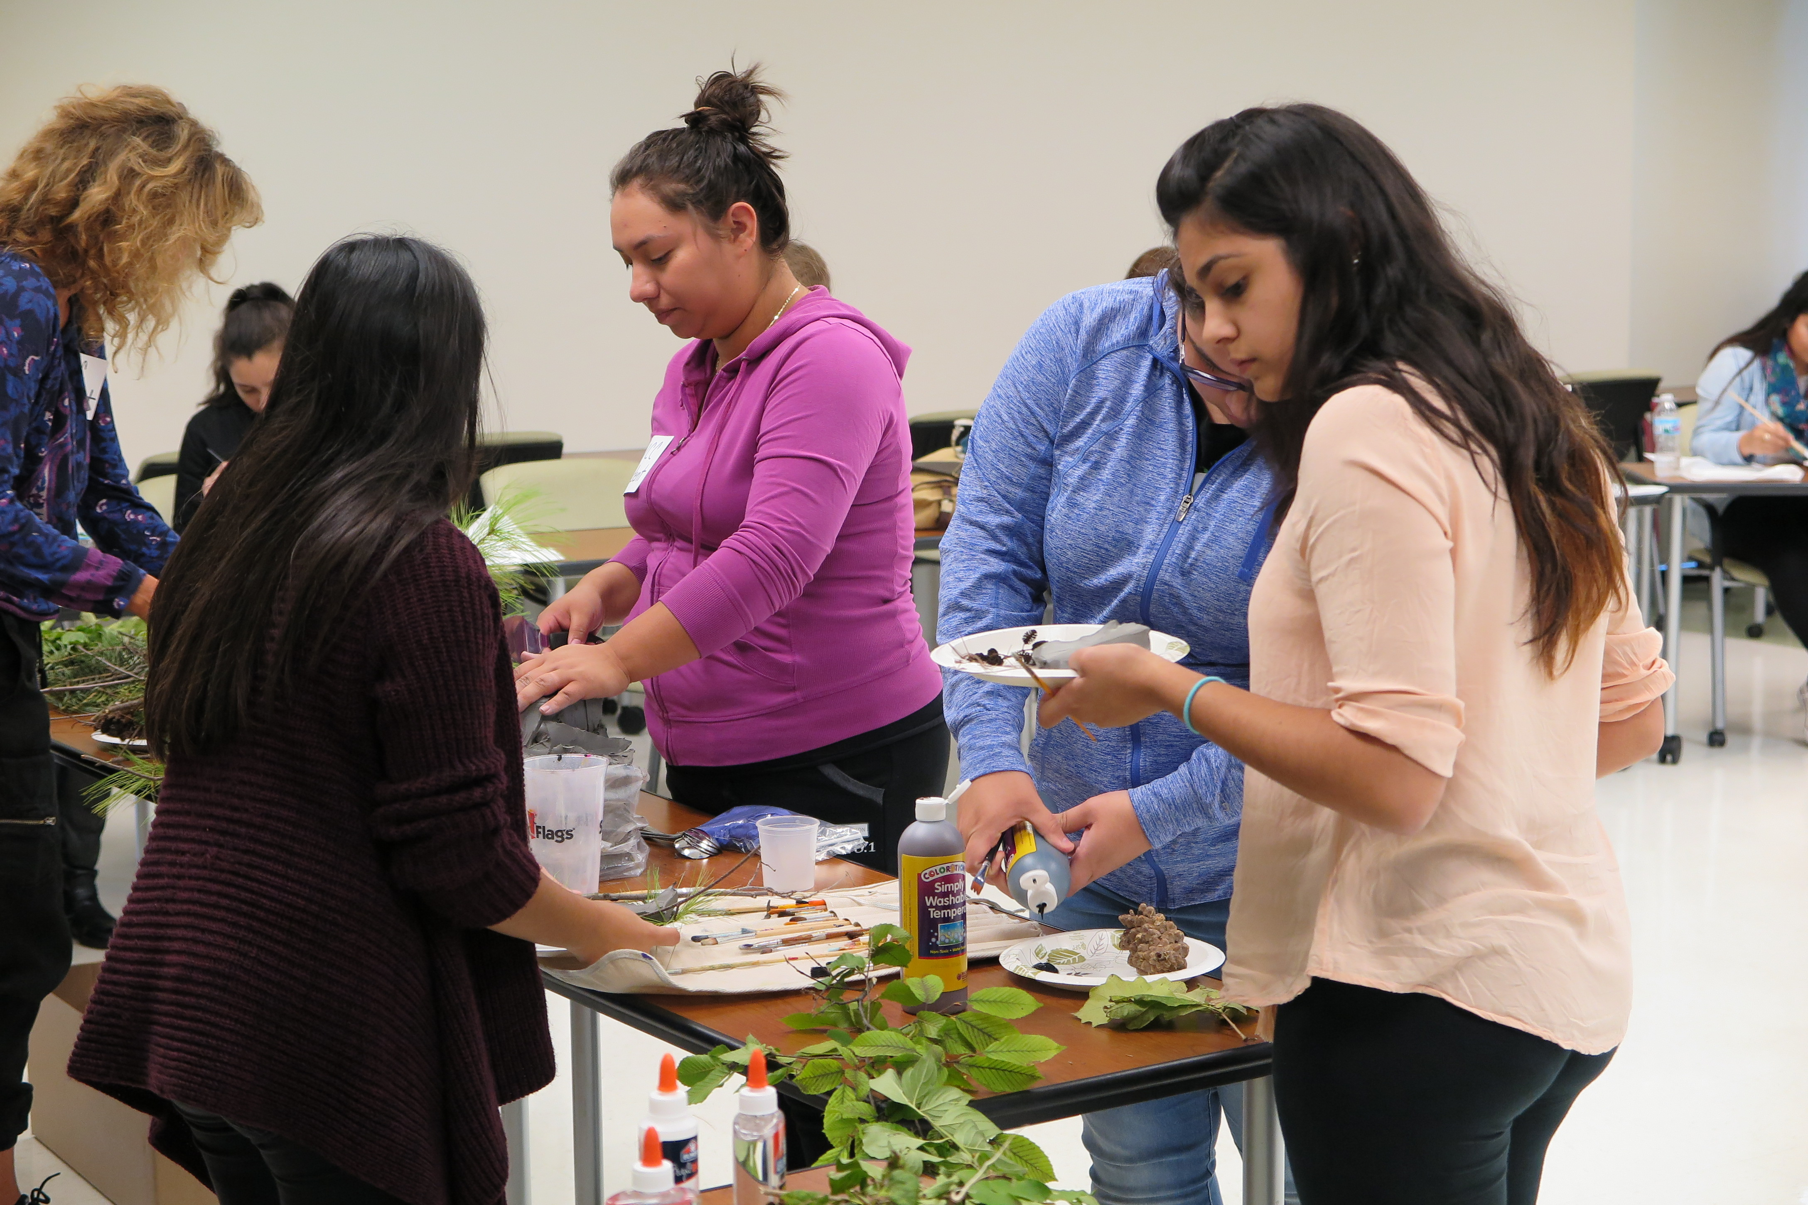

Slide 18
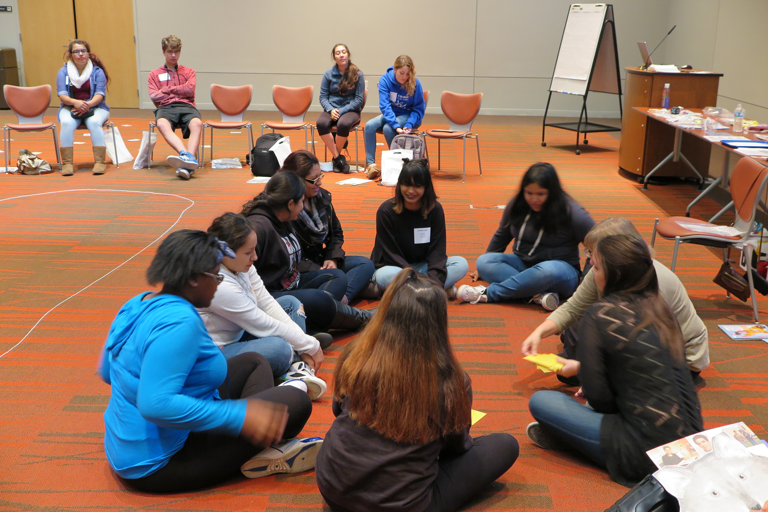

Slide 19
Perkins Uses of Funds & Costs
Required & Permissive Uses of Funds
Costs
Link career and technical education at the secondary level and career and technical education at the postsecondary level (R)
Provide students with strong experience in and understanding of all aspects of an industry (R)
Provide information on postsecondary and career options
Transportation to and from the college & substitute teacher – local and/or VALEES funds (CTEI or Perkins)
Substitute teacher – local and/or VALEES funds (CTEI or Perkins)
Lunch – Waubonsee Community College (Perkins)
Stipends for non-faculty/staff workshop presentations – Waubonsee Community College (Perkins)

Slide 20
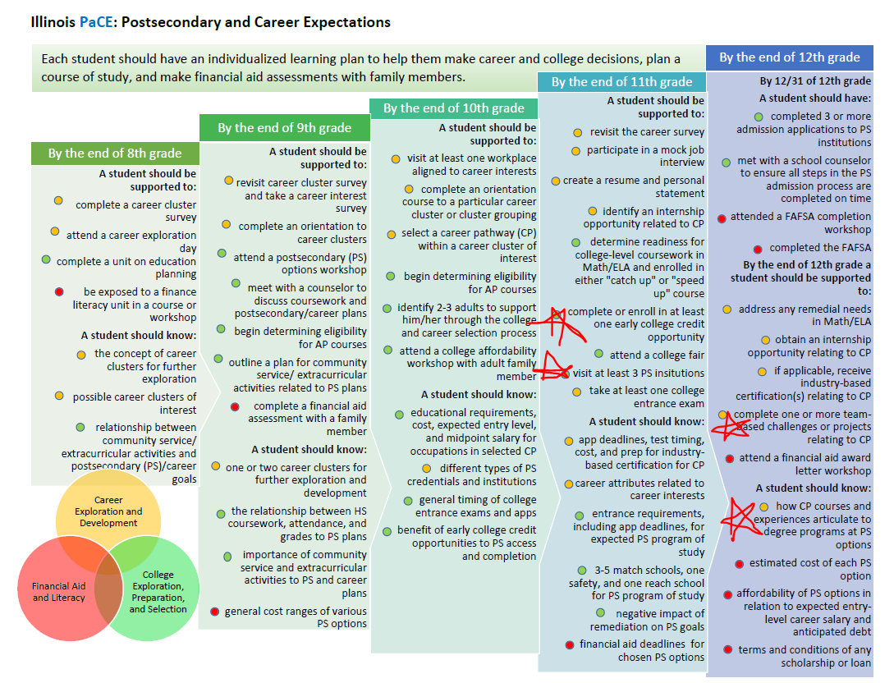

Slide 21
Questions & Answers
www.valees.org For presentation materials, select Program Committees, then Early Childhood.
Cassie Blickem, VALEES
cblickem@waubonsee.edu
630-466-2905
Linda O’Connell-Knuth, Waubonsee Community College
loconnellknuth@Waubonsee.edu
630-466-6698

